Slide 1

GITINSIGHT
Revolutionizing Git Insights

Slide 2

Introduction
GitInsight is an innovative web application designed to offer intuitive and insightful analytics on Git repositories. By leveraging advanced AI/ML models, including GPT-4 and RAG, GitInsight allows users to interact through a user-friendly chat interface, asking open-ended questions to gain a deeper understanding of Git commits.
Our aim is to make complex Git data accessible to developers, project managers, and non-technical users alike, without the need for command-line expertise.
Technologies:
Backend: Flask, Chroma DB, llama-index, Cassio
Frontend: React, Tailwind CSS
AI/ML Modeling: RAG
Deployment: Netlify (frontend), AWS (backend)

Slide 3
Problem Statement
Git repositories contain complex data sets that are critical for projects but difficult to parse without technical expertise, which the Managers usually do not have.
Traditional Git interfaces primarily rely on command-line interactions, posing a significant barrier for non-technical stakeholders.
Lack of intuitive access to Git data slows down decision-making and reduces overall efficiency in project management.

Slide 4
Solution Overview
A web application that transforms GitHub repositories into easily navigable insights through a powerful AI-driven interface.
Users enter a GitHub repository URL, which GitInsight then parses, converting the repository data into a PDF.
The parsed information is stored in a vector database, enabling efficient and complex data queries
A chatbot interface allows users to ask questions regarding repository details, such as recent commits or contributor statistics.
Utilizes cutting-edge technologies including React, Flask, and the RAG model.

Slide 5
SELLING POINTS IN MARKET
Accessibility: Makes complex Git data easily accessible to both technical and non-technical users.
Productivity Booster: Reduces time spent on data extraction and analysis, accelerating project management tasks.
Advanced AI Integration: Utilizes advanced AI models to enhance data analysis and response accuracy.
Scalable Solution: Designed to efficiently handle varying scales of user loads, from small teams to large enterprises.

Slide 6
Robustness/Fault tolerence
Error Handling: Ensures stability and continuous operation with robust error management systems.
High Availability: Has regular backups to maintain service even during system failures.
Load Management: Incorporates load balancing to ensure smooth user experiences under high traffic conditions.
Continuous Improvement: Regular updates and maintenance via a CI/CD pipeline enhance system integrity and performance over time.

Slide 7
List of finished features
LOGIN: Features secure login and registration functionality.
RESPONSIVENESS: Utilized React and Tailwind CSS to offer a responsive and aesthetically pleasing user interface suitable for various devices.
MODEL: Employed the Retrieval-Augmented Generation (RAG) model to enhance the accuracy and relevance of chatbot responses.
DEPLOYMENT: Leveraged AWS for hosting both frontend and backend, ensuring high availability and scalability.
CHATBOT: Includes a quick chat option for commonly asked questions, speeding up user interactions with the chatbot.
OPENAPI KEY: Application functions without a mandatory OpenAI API key, simplifying setup.

Slide 8
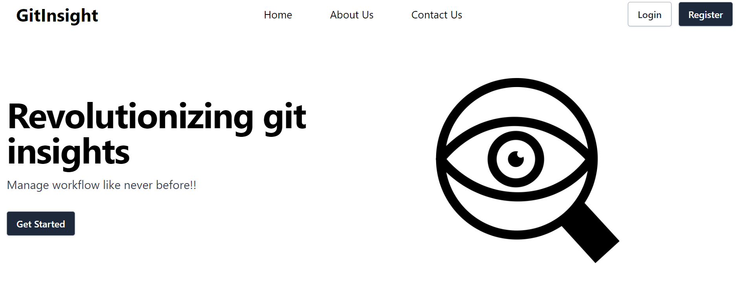
Landing page
Our landing page displays the Logo, Navbar and Hero Sections as shown in the picture. Below are the few functionalities available to user on the landing page. Home: Clicking home on the landing page navigates the page to the landing page home screen from anywhere else.
About us: This section has the details of the project developers.
Contact: This section has contact info of the developers. Log In: This option navigates the users to the login page. Register: This option navigates the users to the sign up page where they can create their new account.

Slide 9
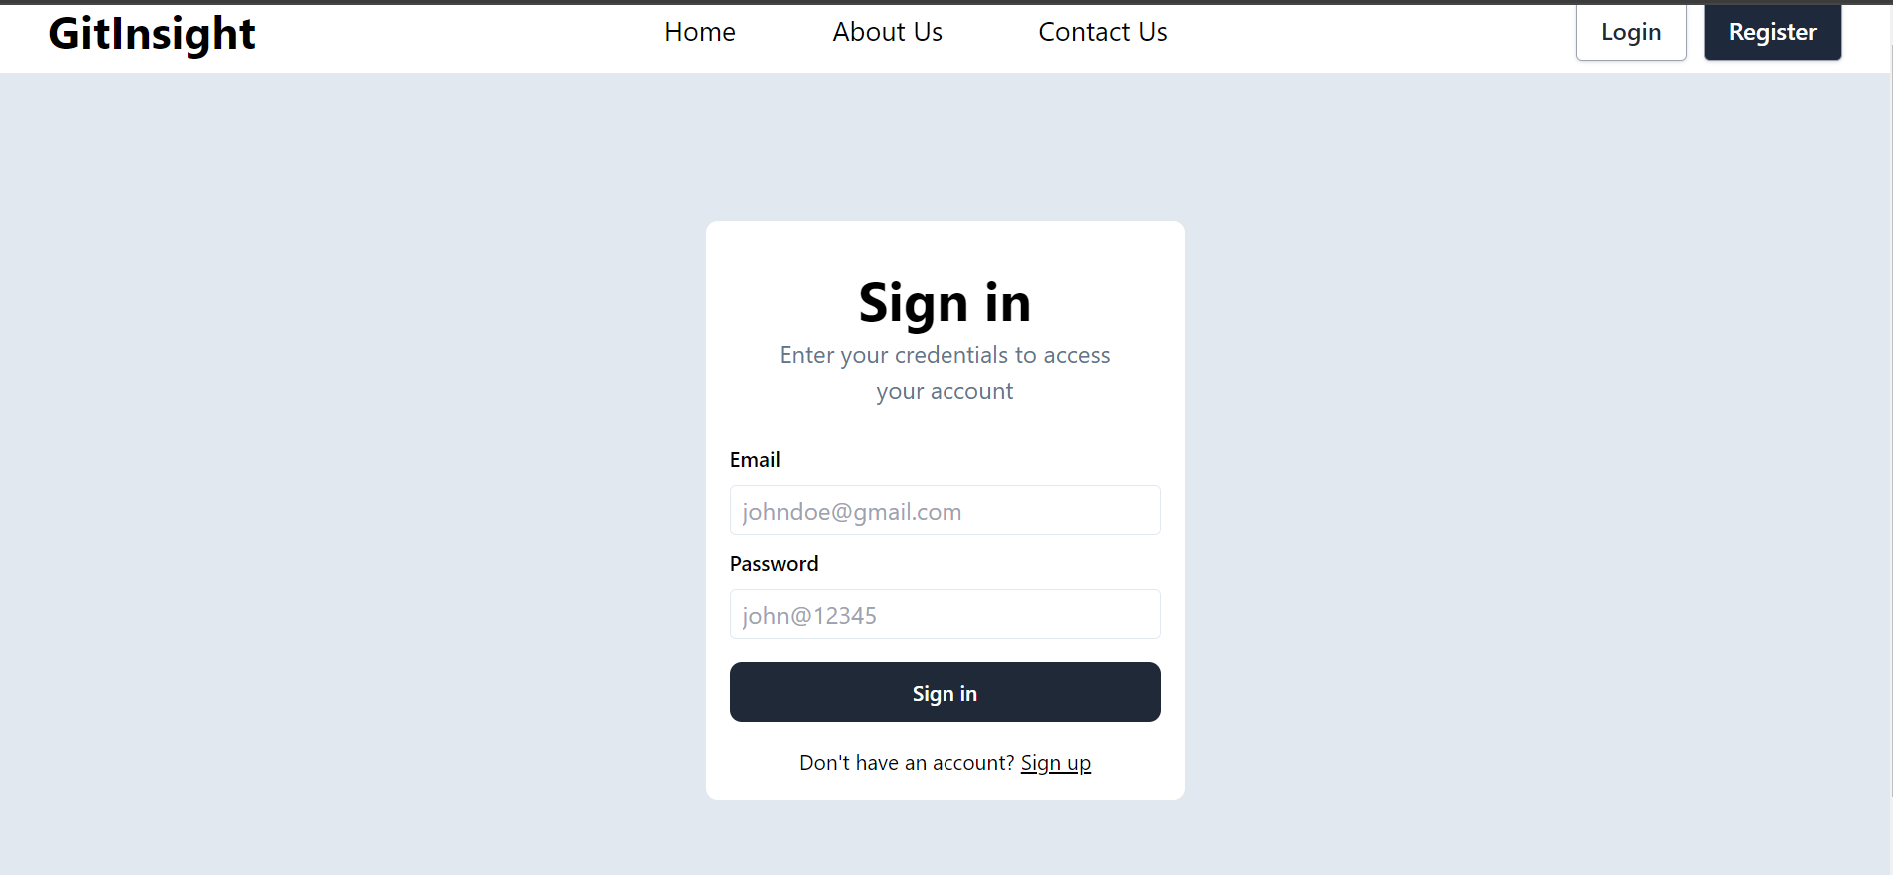
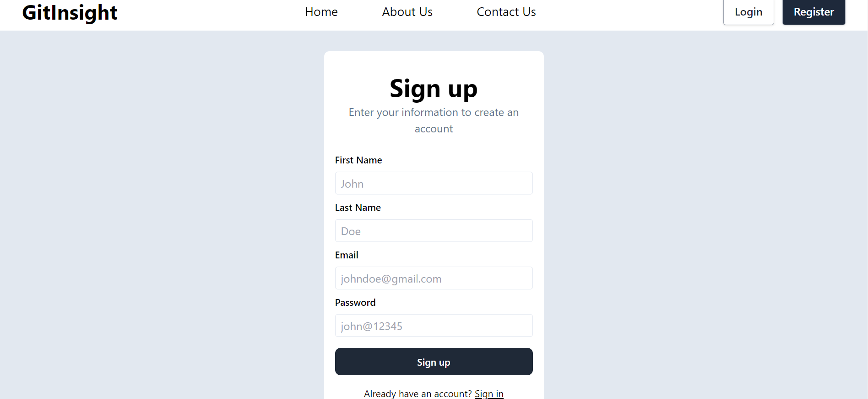
User Login and Signup

Slide 10
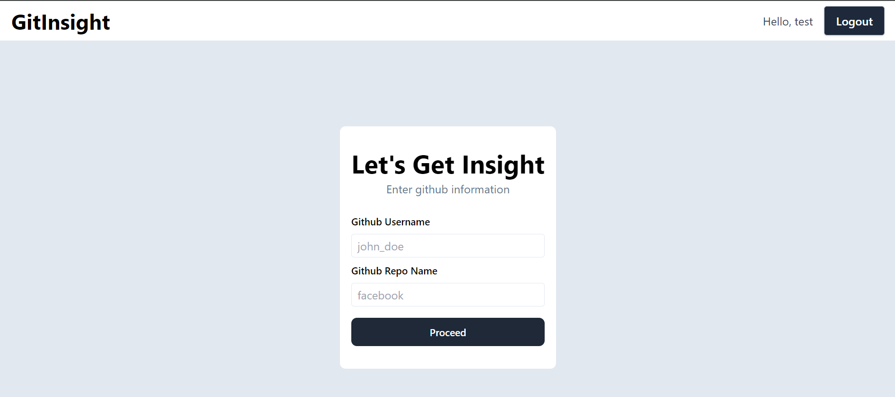
User Dashboard Page

Slide 11
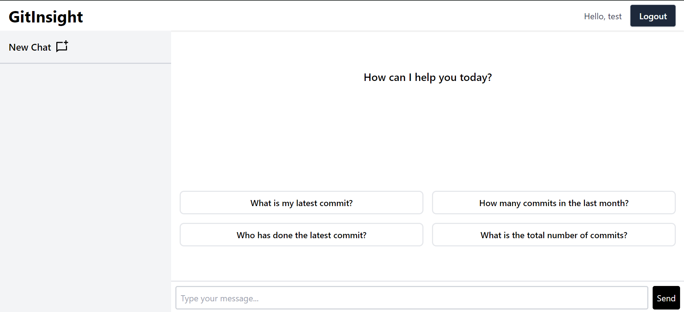
User Chatbot Page

Slide 12
Instructions to Build
Steps to run project locally:
Clone the project from the github using git command git clone “github repo link”.
Navigate to the directory of the frontend using “cd dev/frontend” and run command “npm install”. This command will install all the dependencies.
Then run the command “npm run dev”. This command runs the frontend in the development mode.
Open http://localhost:5173 to view frontend running in your browser.
Open new terminal and navigate to the directory of the backend using cd dev/backend and run command “pip install –r requirements.txt”. This command will install all the dependencies.
Then run the command “python app.py”. This command runs the backend in the development mode.

Slide 13
Demo
Project Live Demo
Our project is now live at: https://663c9b157c707700084970d2--gitinsight-ai.netlify.app/

Slide 14

Summarizing progress
Completed Action Items:
Completed Landing Page with improved design and functionalities such as user login and logout.
Improved Chatbot UI and user input boxes.
Added quick chat feature on the chatbot.
Improved backend model accuracy and response time.
Deployed frontend on Netlify and backend on AWS.

Slide 15
Hosting methods
Frontend Hosting: The React-based frontend is hosted on netlify, providing a globally accessible and fast user experience.
Backend Services: Our Flask backend runs on AWS, ensuring reliable and scalable request handling for GitInsight's operations.
Deployment: Utilizing Netlify for frontend and AWS for backend, we ensure a streamlined and secure deployment process, focusing on performance and scalability.

Slide 16

Feedback From the partner team
Bug: Currently, there are no bugs that requires immediate action.
Enhancement:
Partner Team Feedback:
Implement User login Page instead of directly taking inputs from the user without any login functionality. (Byte Squad).
Make OpenAI API key as optional (Professor) - Partner Team is able to run the project by following the build instructions.

Slide 17
Conclusion
GitInsight stands at the intersection of technology and ease, offering a unique solution to navigate and understand Git repositories effortlessly.
Our journey is ongoing, and we're excited about the potential GitInsight has to transform project management and development workflows.

